Slide 1
7FNCE040W
Business Analytics
WEEK 8
Multidimensional Scaling

Slide 2
Today’s Schedule
MDS
Make your own maps
Group course work

Slide 3
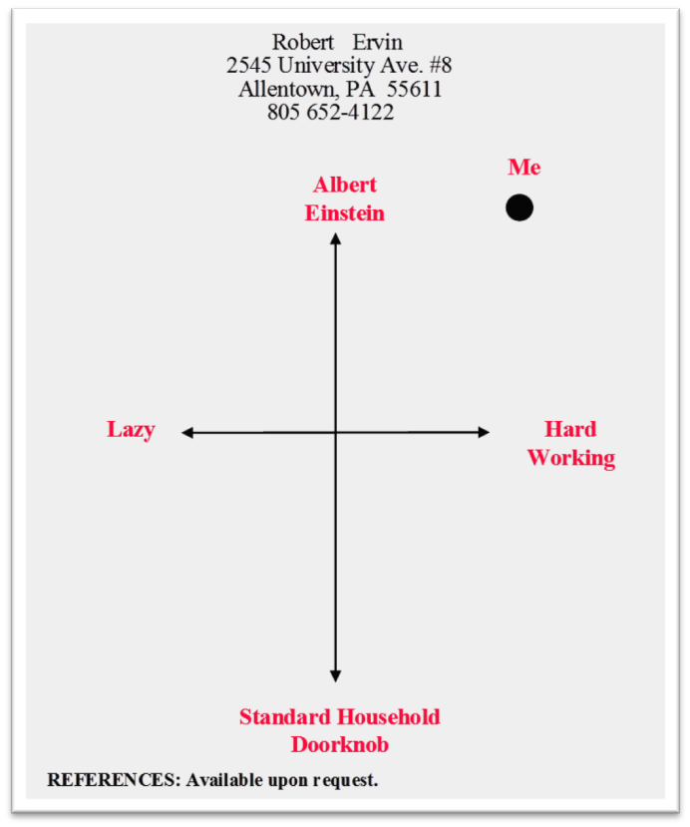
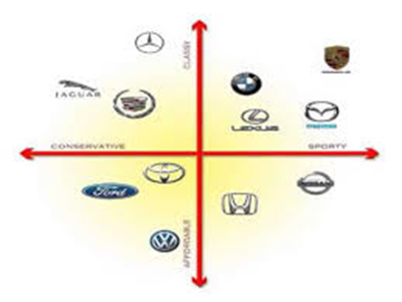
What are Perceptual Maps and MDS?
Notes:
Perceptual mapping is a marketing research technique where you attempt to determine how different product brands are perceived by consumers when mapped – or compared – on two or more product dimensions.
Multidimensional scaling (MDS ) is also known as perceptual mapping
A procedure that allows a researcher to determine the perceived relative position of a set of objects (firms, products, ideas, or other items associated with commonly held perceptions)
The purpose of MDS is to transform consumer judgments of overall similarity or preference (e.g., preference for stores or brands) into distances represented in multidimensional space.
Why perceptions?
Perceptions are not equal to reality (e.g., perceived vs. actual quality of German cars, particularly Mercedes, VW).
Customers buy based on perceptions.

Slide 4
Key Pieces of Information?
Brands
Axes
Distance or Similarity Measure

Slide 5
Key Insights from Positioning Maps
Brands versus brands
How consumers perceive a brand relative to the others
Which brands are the closest competitors
Which brands have a unique position
Are there opportunities for new or existing brands
Axes and brands
The major dimensions used to distinguish the brands
The location (or position) of a particular brand
A better location (or position) for a new or existing brand
Notes:
From the positions of brands versus brands
How consumers perceive a brand relative to the others
Which brands are the closest competitors
Which brands have a unique position
Are there opportunities for new or existing brands
From the positions of brands versus the axes (dimensions)
The major dimensions (attributes) used to distinguish the brands
The location (or position) of a particular brand
A better location (or position) for a new or existing brand

Slide 6
Key Insights from Positioning Maps
Brands versus brands
How consumers perceive a brand relative to the others
Which brands are the closest competitors
Which brands have a unique position
Are there opportunities for new or existing brands
Axes and brands
The major dimensions used to distinguish the brands
The location (or position) of a particular brand
A better location (or position) for a new or existing brand
Notes:
From the positions of brands versus brands
How consumers perceive a brand relative to the others
Which brands are the closest competitors
Which brands have a unique position
Are there opportunities for new or existing brands
From the positions of brands versus the axes (dimensions)
The major dimensions (attributes) used to distinguish the brands
The location (or position) of a particular brand
A better location (or position) for a new or existing brand

Slide 7
Key Insights from Positioning Maps
Brands versus brands
How consumers perceive a brand relative to the others
Which brands are the closest competitors
Which brands have a unique position
Are there opportunities for new or existing brands
Axes and brands
The major dimensions used to distinguish the brands
The location (or position) of a particular brand
A better location (or position) for a new or existing brand
Notes:
From the positions of brands versus brands
How consumers perceive a brand relative to the others
Which brands are the closest competitors
Which brands have a unique position
Are there opportunities for new or existing brands
From the positions of brands versus the axes (dimensions)
The major dimensions (attributes) used to distinguish the brands
The location (or position) of a particular brand
A better location (or position) for a new or existing brand

Slide 8
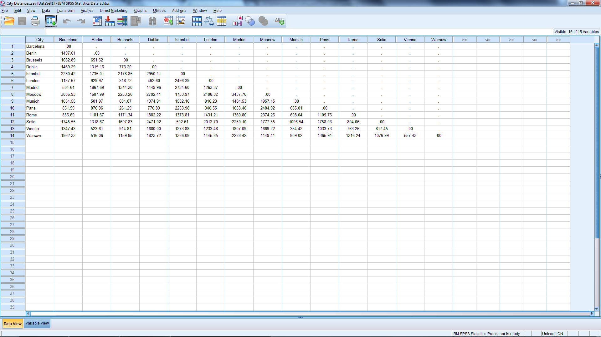
Distance Between EU Cities
Notes:
Open City Distances.sav
14 Cities
Row/column is distance
0’s on diagonal
Symmetric matrix

Slide 9
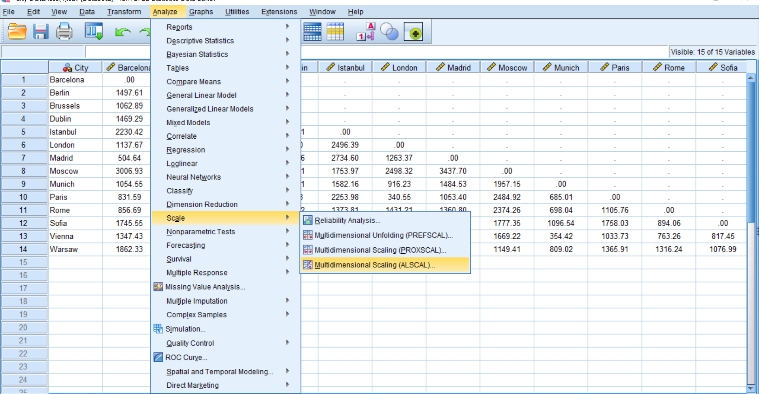
MDS
From Scale Menu
Other Options
ALSCAL
PROXSCAL
PREFSCAL
Notes:
The use of Multidimensional Scaling is most appropriate when the goal of your analysis is to find the structure in a set of distance measures between a single set of objects or cases.
ALSCAL is the base system.
PROXSCAL offers an accelerated algorithm for certain models and allows you to put restrictions on the common space.
PROXSCAL attempts to minimize normalized raw stress rather than S-stress (also referred to as strain).
The normalized raw stress may be preferred because it is a measure based on the distances, while the stress is based on the squared distances.
PREFSCAL attempts to minimize a penalized stress measure that helps it to avoid degenerate solutions.

Slide 10
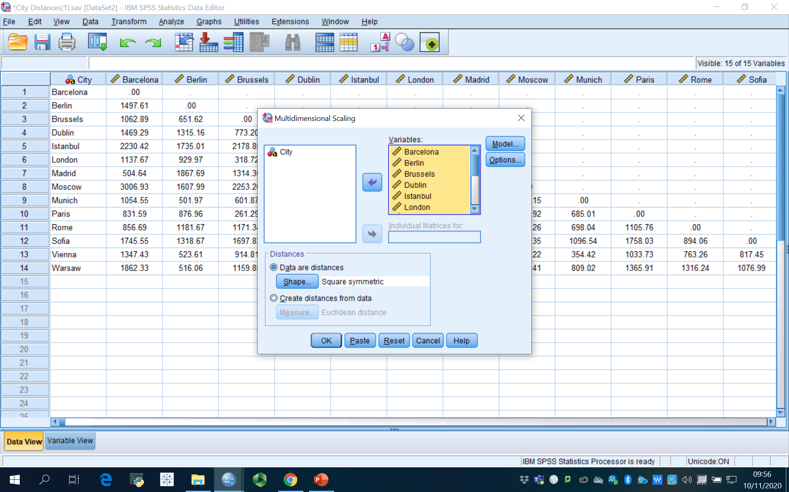
MDS
Select 14 Cities
Data are Distances
Notes:
Distance Box
Data are Distances
Shape Square Symmetric

Slide 11
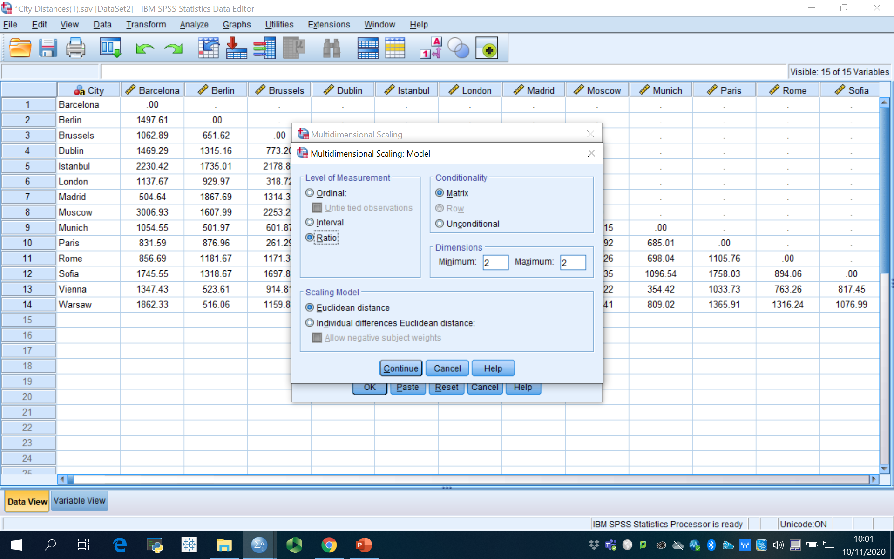
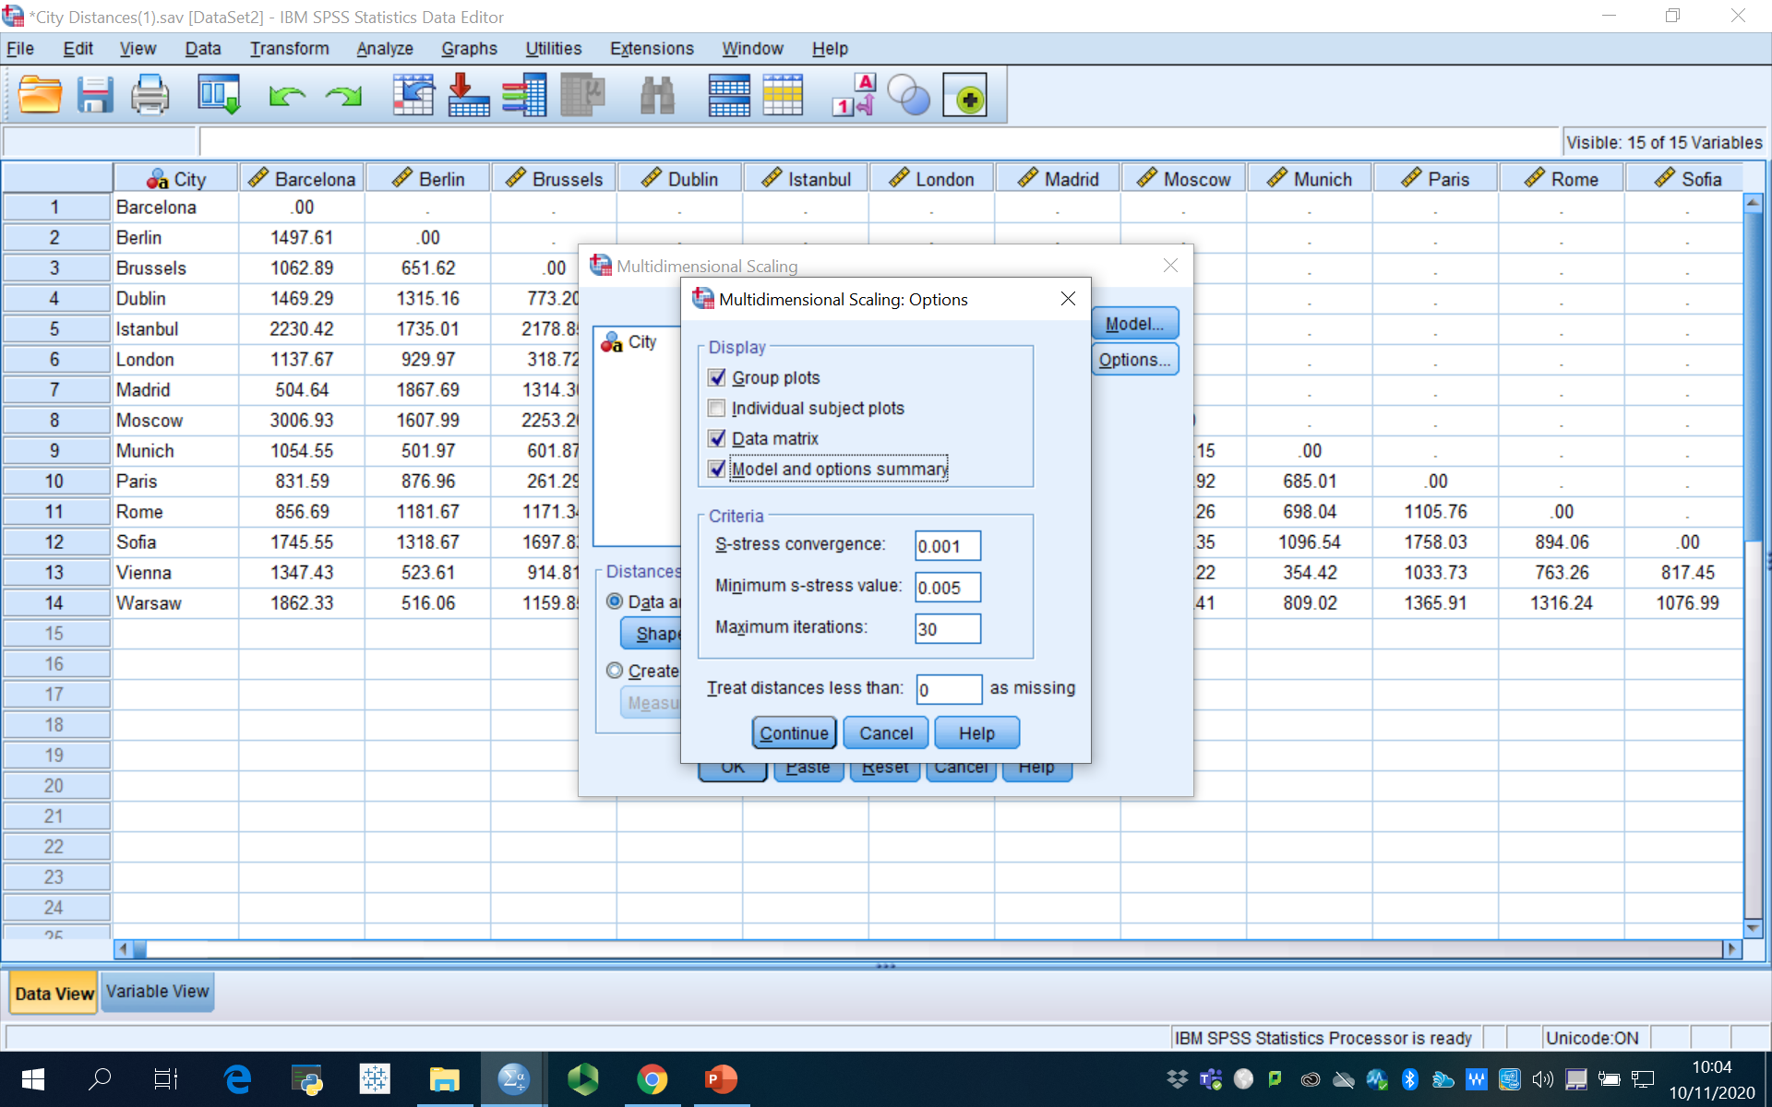
MDS
Model Dialog Box
Options Dialog Box
Notes:
Model
Level of measurement
The level of measurement can be ordinal, interval, or ratio
In this case it is ratio.
Conditionality
Matrix
One can assume that two different respondents may use different subjective scales when they judge the dissimilarity of a set of brands or objects. If this assumption is made for all subjects, the data are referred to as matrix conditional.
Scaling Model
Euclidean Distance
Dimensions
Minimum = 2 & Maximum = 2
Options
Display
Group Plot
Data Matrix
Model & options summary
Criteria
Leave defaults

Slide 12
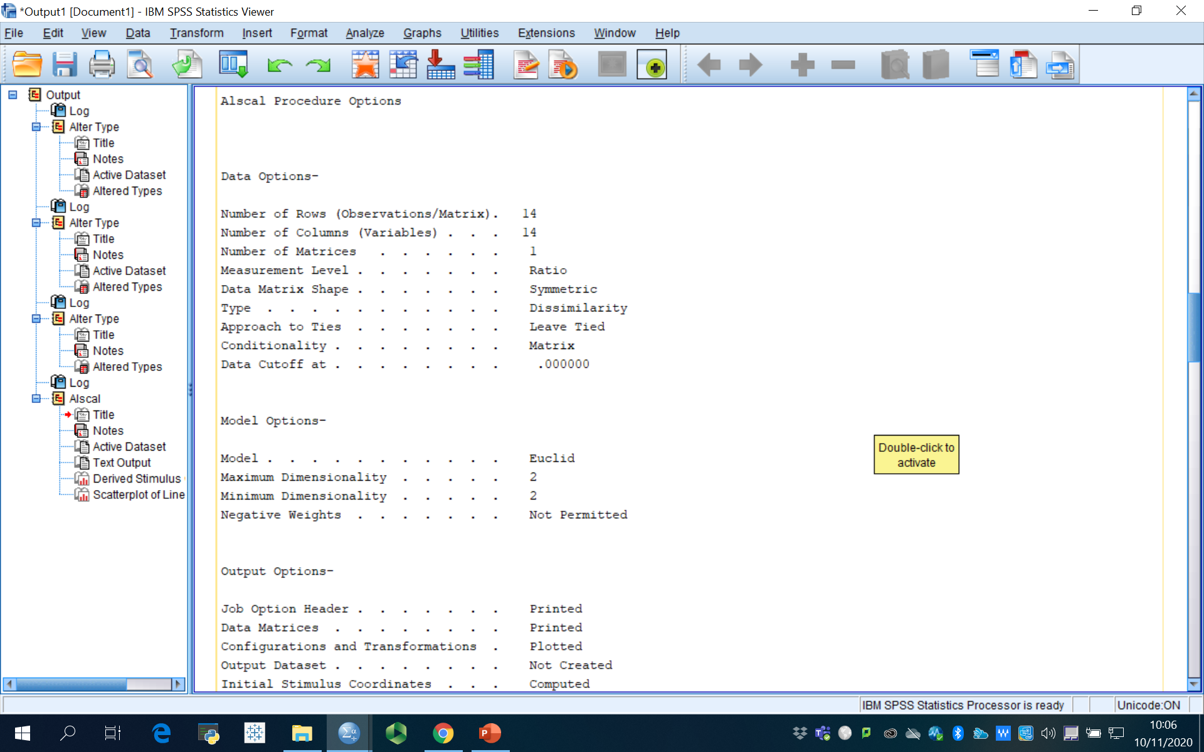
Model & Options Summary

Slide 13
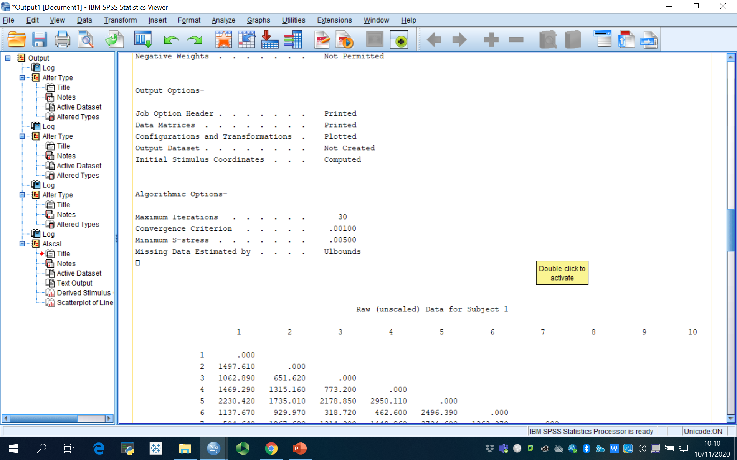
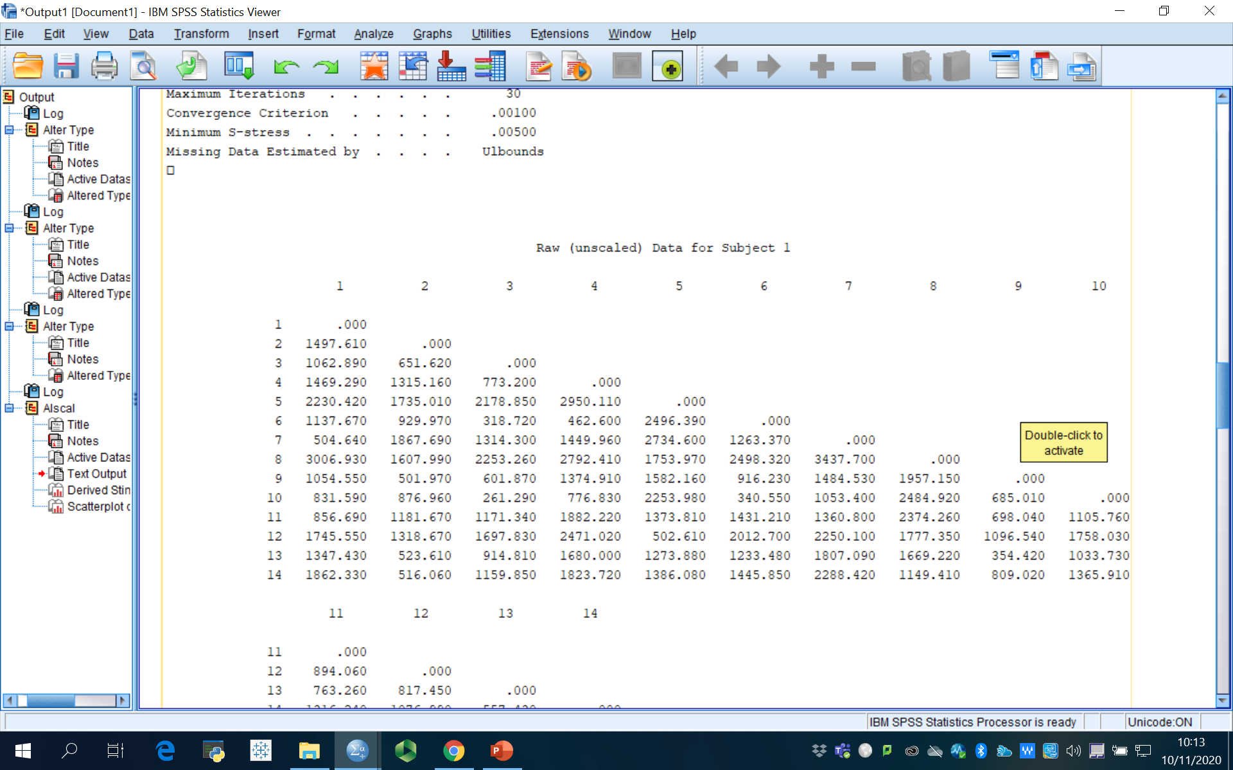
Output: Coordinates & Distances
Notes:
In creating the map, the algorithm moves the points around trying to maintain the relative original distances between any two. It continues (iterates) until it can not make any additional improvements.

Slide 14
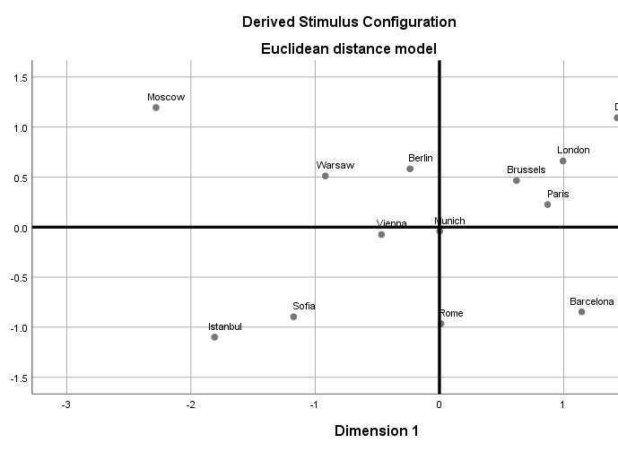
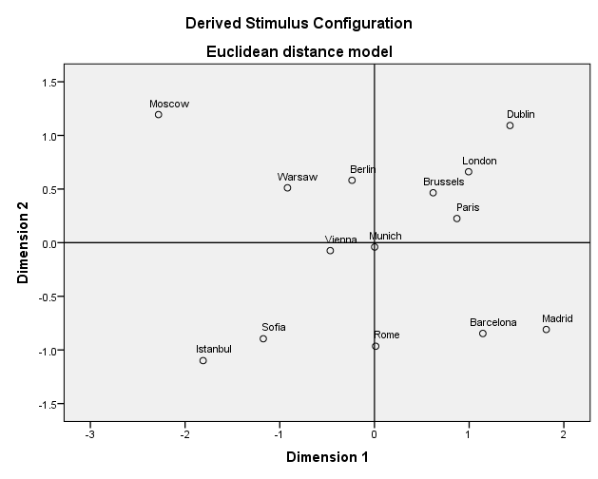
Output: Map
Notes:
In creating the map, the algorithm moves the points around trying to maintain the relative original distances between any two. It continues (iterates) until it can not make any additional improvements.

Slide 15
Key Pieces of Information
Brands |  | Cities |  | Relevant Market
Axes |  | North versus South & East versus West |  | Dimensions used by consumers to differentiate brands
Distance or Similarity Measure |  | Mileage between cities |  | Relative similarity (or dissimilarity) of brands

Slide 16
Key Decisions in MDS
Step 1: Specify the Products and/or Brands to be Used
Step 2: Specify How the Similarities Judgments are to be Obtained and Construct the Stimuli
Step 3: Decide whether Judgments will be Aggregated, and if so, How?
Step 4: Collect the Judgments and Analyse Them to Generate the Perceptual Map
Step 5: Name the Resulting Dimensions
Notes:
Based on Churchill, Gilbert A. Jr. and Dawn Iacobucci (2005), Marketing Research Methodological Foundations, 9th edition, Thomson South-Western Publishers, Figure 18.16, page 610.
The map will be a direct result of the stimuli used. Therefore, the selection of brands to include, and exclude, can have a significant impact on the results. To avoid this mistake researchers often include too many brands, placing such a heavy burden on respondents’ that may lead to low quality data.
Similarity judgments can be obtained directly or indirectly. The direct methods ask respondents’ to compare stimuli (brands) on whatever basis they deem appropriate and state which pair is most similar, next most similar, etc. Indirect methods are the “attribute-based” methods.
Individual maps (one from each respondent) are difficult to compare and synthesize. There are several options available to combine respondents.

Slide 17
Select Brands to Include
Minimise number of objects for respondent’s task
≥ 4 times as many objects as dimensions
Notes:
Select the brands or other stimuli to be included in the analysis. The number of brands or stimuli selected normally varies between 8 and 25.
The choice of the number and specific brands or stimuli to be included should be based on the statement of the marketing research problem, theory, and the judgment of the researcher.
The number of objects to be evaluated is a tradeoff between
a small number of objects to facilitate the respondents’ task
four times as many objects as dimensions desired (i.e., 5 objects for one dimension, 9 objects for two dimensions . . . ) to obtain a stable solution.

Slide 18
Approaches to Developing Maps
Perceptual Maps
Direct Approach
Attribute-Based
Non attribute-based
Indirect (Derived) Approach
Notes:
Based on Churchill, Gilbert A. Jr. and Dawn Iacobucci (2005), Marketing Research Methodological Foundations, 9th edition, Thomson South-Western Publishers, Figure 18.13, page 605.

Slide 19
Direct Approach – (Dis)Similarity Judgments
Brand Pair | Very Similar |  |  |  |  |  | Very Dissimilar
Crest / Colgate | 1 | 2 | 3 | 4 | 5 | 6 | 7
Aqua-Fresh / Crest | 1 | 2 | 3 | 4 | 5 | 6 | 7
Crest / Aim | 1 | 2 | 3 | 4 | 5 | 6 | 7
…
Colgate / Aqua-Fresh | 1 | 2 | 3 | 4 | 5 | 6 | 7
Notes:
Perception Data – Direct Approaches
In direct approaches to gathering perception data, the respondents are asked to judge how similar or dissimilar the various brands or stimuli are, using their own criteria.
These data are referred to as similarity judgments
The number of pairs to be evaluated is n (n -1)/2, where n is the number of stimuli.

Slide 20
Indirect Approach – For Each Attribute
Brand | Attribute 1
 | Poor |  |  |  |  |  | Excellent
Lexus | 1 | 2 | 3 | 4 | 5 | 6 | 7
Infiniti | 1 | 2 | 3 | 4 | 5 | 6 | 7
BMW | 1 | 2 | 3 | 4 | 5 | 6 | 7
… | 1 | 2 | 3 | 4 | 5 | 6 | 7
Rolls Royce | 1 | 2 | 3 | 4 | 5 | 6 | 7
Notes:
Perception Data – Derived Approaches
Derived approaches to collecting perception data are attribute-based approaches requiring the respondents to rate the brands or stimuli on the identified attributes using semantic differential or Likert scales.
The question above would be repeated for each attribute
If attribute ratings are obtained, a similarity measure (such as Euclidean distance) is derived for each pair of brands.

Slide 21
Decisions
Both Approaches – Brands
Indirect – Also Attributes
Lexus
Infiniti
BMW
Mercedes
Cadillac
Lincoln
Porsche
Bentley
Rolls Royce
Prestige
Performance
Luxury
Value

Slide 22
Individual or Aggregate
One Map per Respondent
One Map per Cluster (Segment)
One Map for Entire Sample
Notes:
First we will prepare one map per respondent.
Instructions will be provided on how to add more respondents.

Slide 23
Multidimensional Scaling Method
Input Data
Output
Metric
Interval or Ratio Data
Non-Metric Data
Ordinal or Nominal Data
May need to standardise data
Metric – Distances
Direct Method
If S_{AB} ≤ S_{CD} then D_{AB} ≤ D_{CD}
Indirect Method
Calculates a distance from data
If D′_{AB} ≤ D′_{CD} then D_{AB} ≤ D_{CD}
Minimize size of mistakes
Notes:
Selection of a specific MDS procedure depends upon:
The nature of the input data is also a determining factor.
Non-metric MDS procedures assume that the input data are ordinal or nominal, but they result in metric output.
Ordinal: Rank order to the categories
1st, 2nd choices
Salary range
Nominal: Categories (race, religion, gender)
Metric MDS methods assume that input data are metric. Since the output is also metric, a stronger relationship between the output and input data is maintained, and the metric (interval or ratio) qualities of the input data are preserved.
Ratio: Actual number
True zero exists
Dollars spent, miles traveled
Interval: Distance between each descriptor is known and equal
On a scale of 1 – 7
Entire scale is a continuum
The metric and non-metric methods produce similar results.

Slide 24
Determine Number of Dimensions
Trade-Off
Diagnostics
Fewer Dimensions Improves Interpretation
More Dimensions
Improves Fit
Judgement
A priori knowledge
Interpretation of map
Ease of use
Statistical approaches
Notes:
Trade-offs are necessary regarding the number of desired dimensions because more dimensions improves fit but also increases the burden put on respondents, which may lead to reduced data quality.
A priori knowledge - Theory or past research may suggest a particular number of dimensions.
Interpretability of the spatial map - Generally, it is difficult to interpret configurations or maps derived in more than three dimensions.
Ease of use - It is generally easier to work with two-dimensional maps or configurations than with those involving more dimensions.
Statistical approaches - Statistical approaches are also available for determining the dimensionality.

Slide 25
Naming the Dimensions
Notes:
Naming the dimensions (axes) is a key step in MDS – interpreting the map.

Slide 26
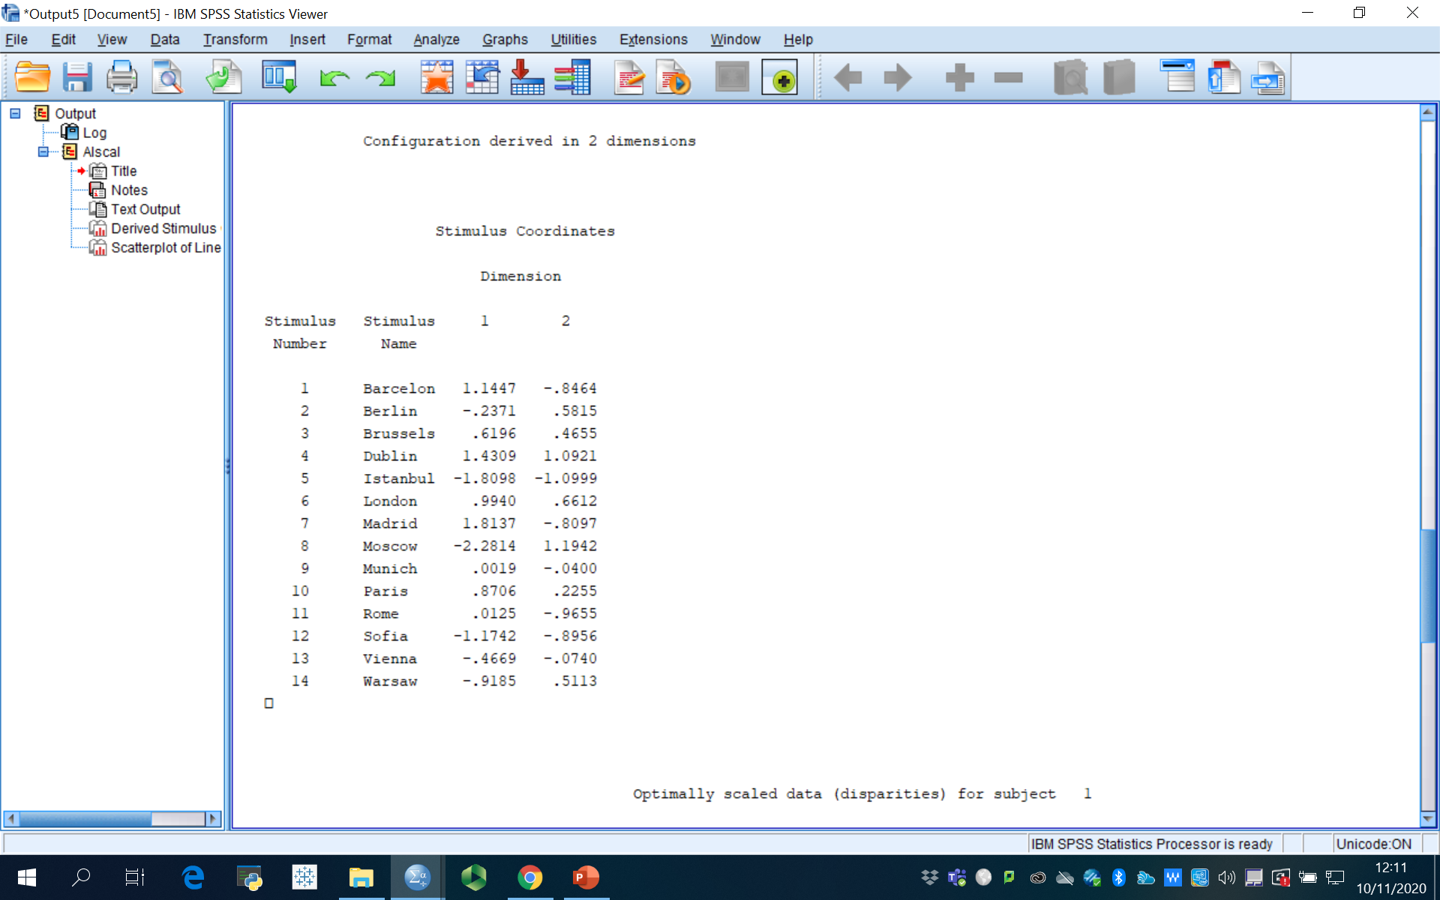
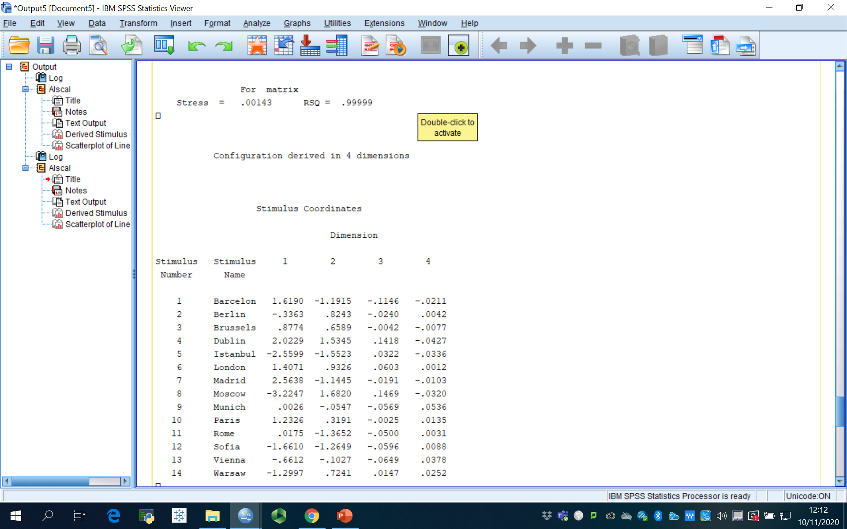
Goodness of Fit Information
2 Dimensions
4 Dimensions
Notes:
The index of fit, or R-square is a squared correlation index that indicates the proportion of variance of the optimally scaled data that can be accounted for by the MDS procedure. Values of 0.60 or better are considered acceptable.
Stress values are also indicative of the quality of MDS solutions. Stress measures badness-of-fit, or the proportion of variance of the optimally scaled data that is not accounted for by the MDS model. Stress values of less than 10% are considered acceptable.
Kruskal’s Stress is a measure of “lack-of-fit” therefore, the lower the better.
Stress Goodness of fit
.200 Poor
.100 Fair
.050 Good
.025 Excellent
.000 Perfect
These outputs show that with more dimensions there is a better fit. However, when increasing the dimensions, the researcher loses the parsimony desired and the objective is to find the lowest dimensional space solution which has a good correspondence with the data.

Slide 27
What is a “Good” Map?
Can you interpret it?
Stress < .10 (Fair) < .05 (Good)
R² > .6
Typically 2 – 3 dimensions are sufficient
More than 3 is just too difficult to interpret
Goodness of Fit

Slide 28
Assumptions & Limitations
Assumptions
Limitations
Dist(A,B) = Dist(B,A)
Similarity (distance) is a function of the similarity of component attributes
Static
Difficult Interpretation
No explanation of why
Preferences ≠ Perceptions
Need 6 – 8 brands
Notes:
Assumptions:
It is assumed that the similarity of stimulus A to B is the same as the similarity of stimulus B to A.
MDS assumes that the distance (similarity) between two stimuli is some function of their partial similarities on each of several perceptual dimensions.
Limitations:
Provides a static model – ignores dynamics of consumer perceptions
Interpretation is sometimes difficult
Does not incorporate cost or likelihood of achieving desired position
Does not indicate why certain perceptions exist
Preferences may be different than perceptions
Need about 6 – 8 brands to make the technique useful

Slide 29
2 Examples
Similarity-based (Direct) & Attribute-based (Indirect) Approaches

Slide 30
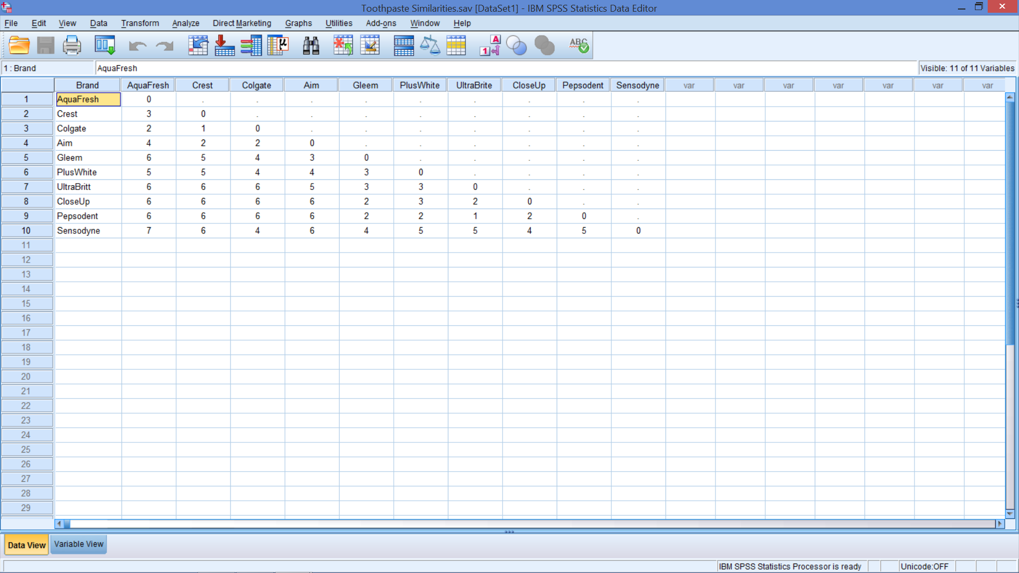
Open Toothpaste Similarities.sav
Notes:
The respondents are asked to judge how dissimilar the various pairs of brands are on a scale of 1 to 7, where 1 is very similar and 7 is very dissimilar.
In this manner the larger numbers indicate more dissimilarity so a greater distance between the brands.
Smaller numbers indicate more similarity and a smaller distance between the brands.
Note that they are not told what criteria to consider so they are using their own criteria.

Slide 31
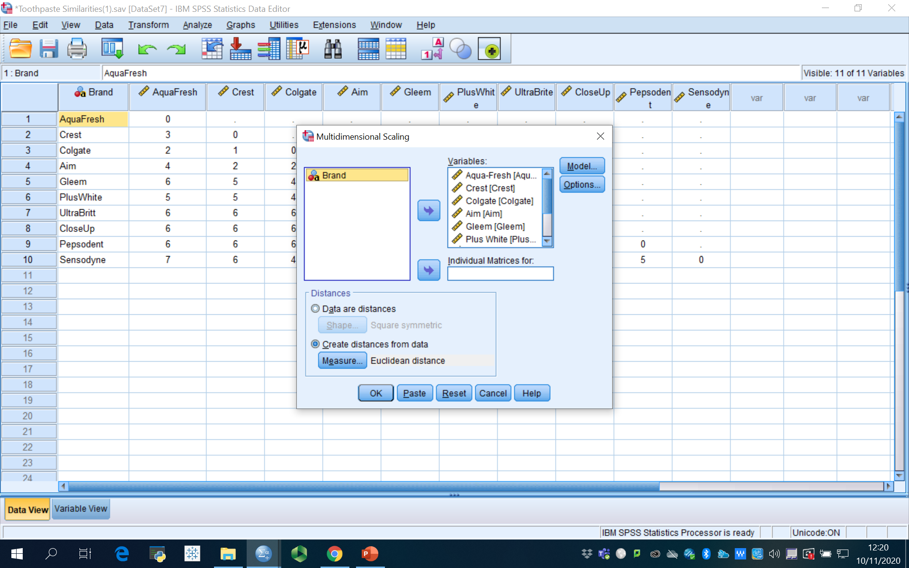

MDS
Scale Menu
Add Brands

Slide 32
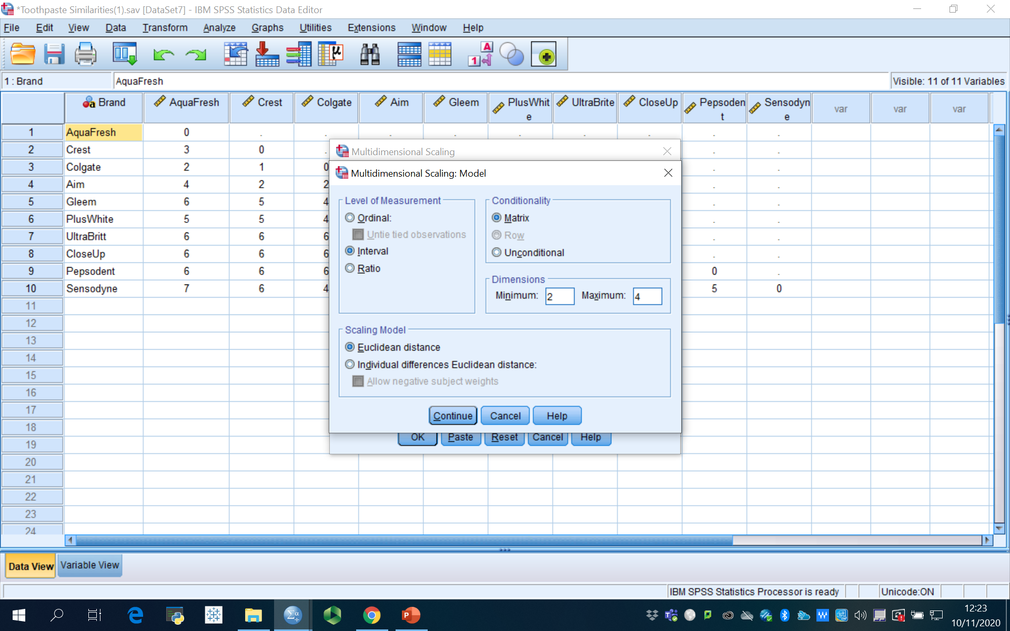
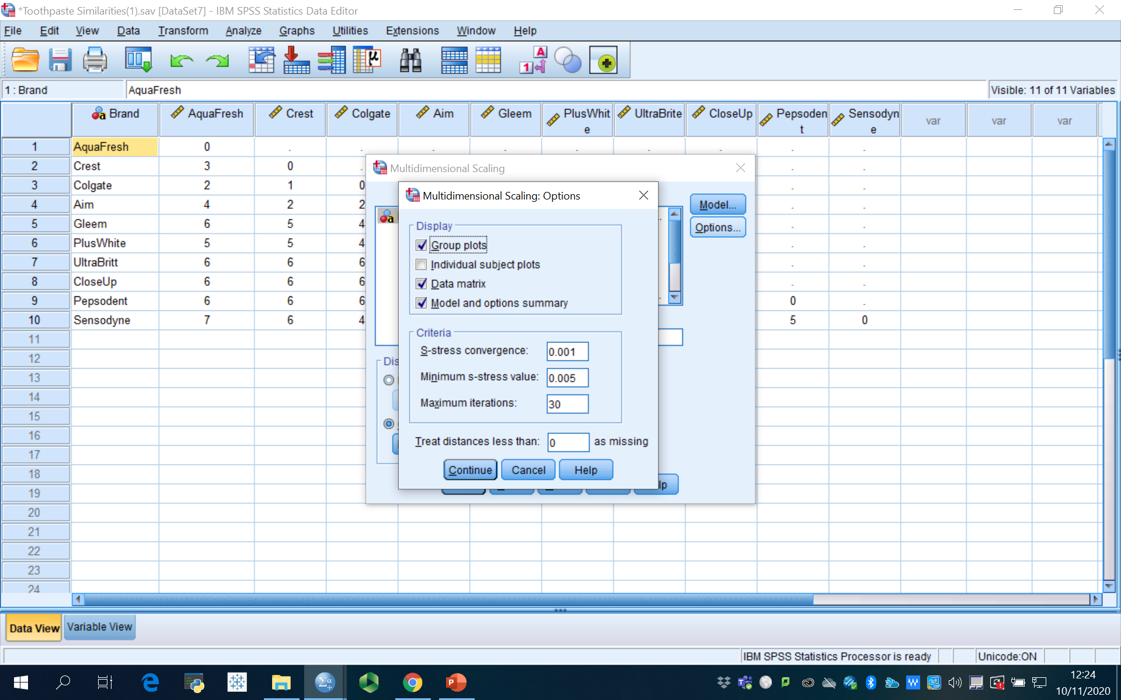
MDS
Options
Model
Notes:
Now, the data are interval data.

Slide 33
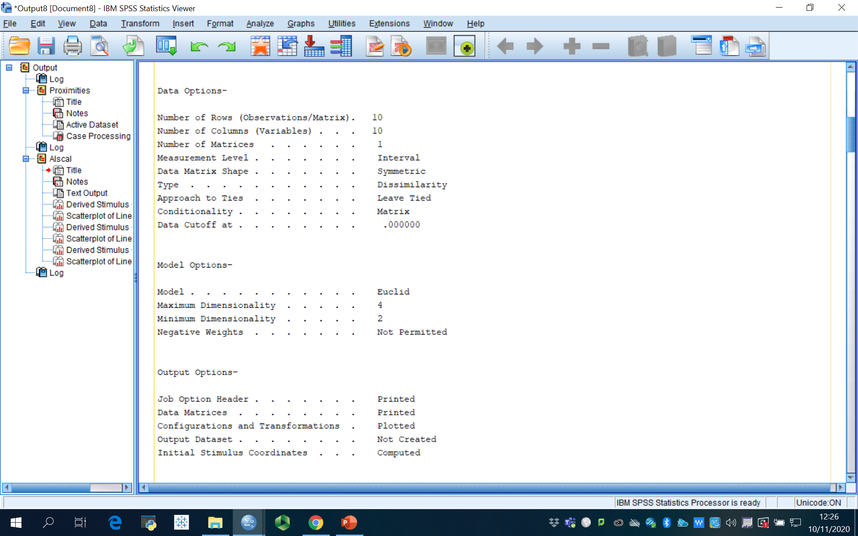
Model Summary

Slide 34
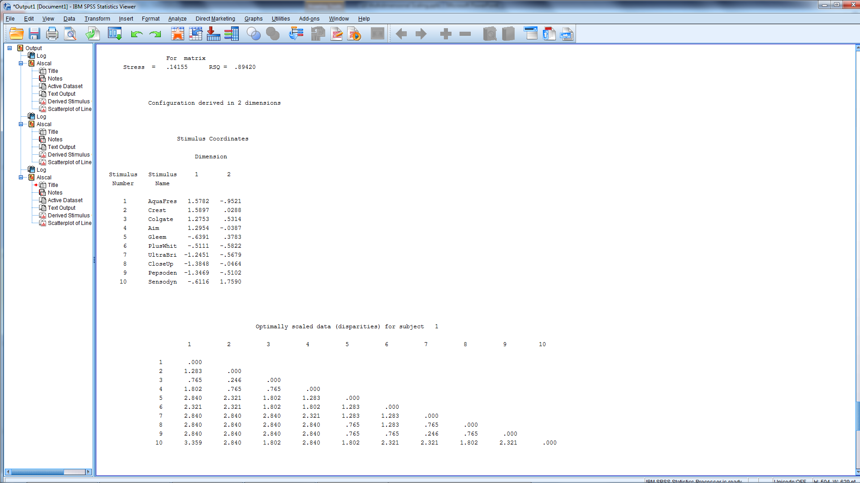
Output: Stress, Coordinates, & Distances

Slide 35
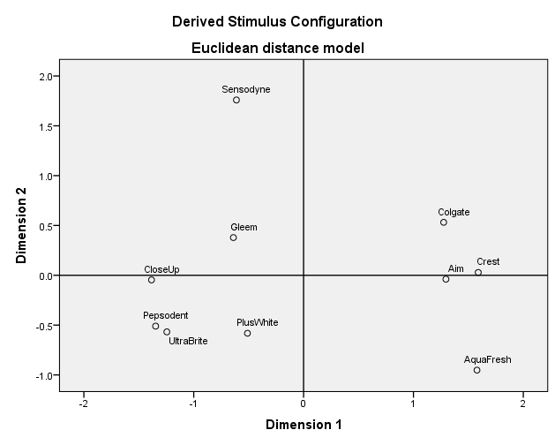
Map – Name the Dimensions
Notes:
Naming the dimensions
The horizontal axis may be labelled as cavity-fighting protection versus whiteness of teeth.
The vertical axis may be sensitivity protection since Sensodyne is by itself.
Naming may be easier when looking at the extremes first.
Even if direct similarity judgments are obtained, ratings of the brands on researcher-supplied attributes may still be collected.
After providing direct similarity or preference data, the respondents may be asked to indicate the criteria they used in making their evaluations.
If possible, the respondents can be shown their spatial maps and asked to label the dimensions by inspecting the configurations.
If objective characteristics of the brands are available (e.g., horsepower or miles per gallon for automobiles), these could be used as an aid in interpreting the subjective dimensions of the spatial maps.

Slide 36
Similarity-based (Direct) Mapping
Places Brands on Map
Need good list of brands
Defines market
Overall assessment of market structure
From brand positions
Closest competitors
“Holes” in the market
From naming axes
Identifies how consumers differentiate the brands
Good information for positioning
No attribute lists
Unsure of the dimensions (axes) that differentiate the brands
Sometimes difficult to describe / identify specific attributes
Notes:
Relevancy: All relevant brands in a product category should be included as the omission of key brands or inclusion of inappropriate brands will have an impact on the derived dimensions and the relative positioning of the brands in the perceptual space.
Comparability: Make sure that the brands or products are comparable in the eye of the consumer. Brands should have a common characteristic (objective or perceived) that consumers can use for comparison (e.g. clothing brands, snacks, alcoholic beverages, etc.).
Number of brands evaluated: It is important to strike a balance between the required number of brands to find a stable multidimensional map, an acceptable level of model fit and the effort required on the part of the respondent to evaluate a number of brands. It is recommended to have more than four times as many brands as dimensions to obtain a stable solution and avoid over-fitting problems.

Slide 37
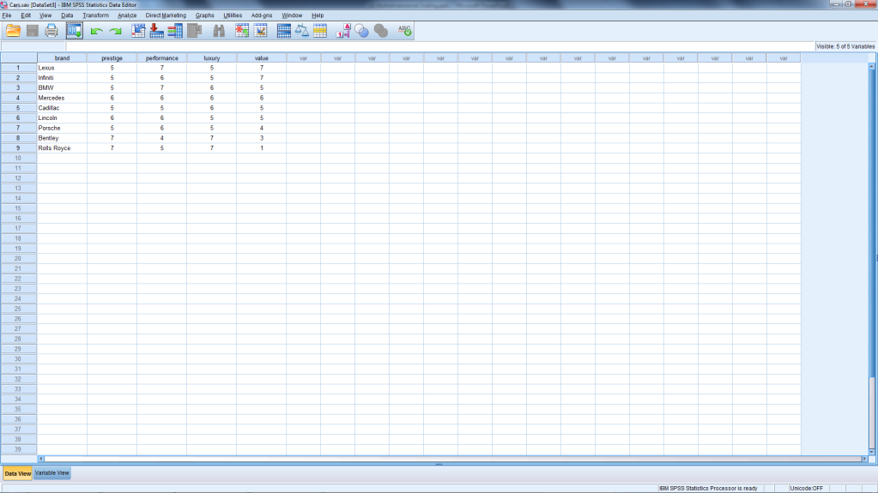
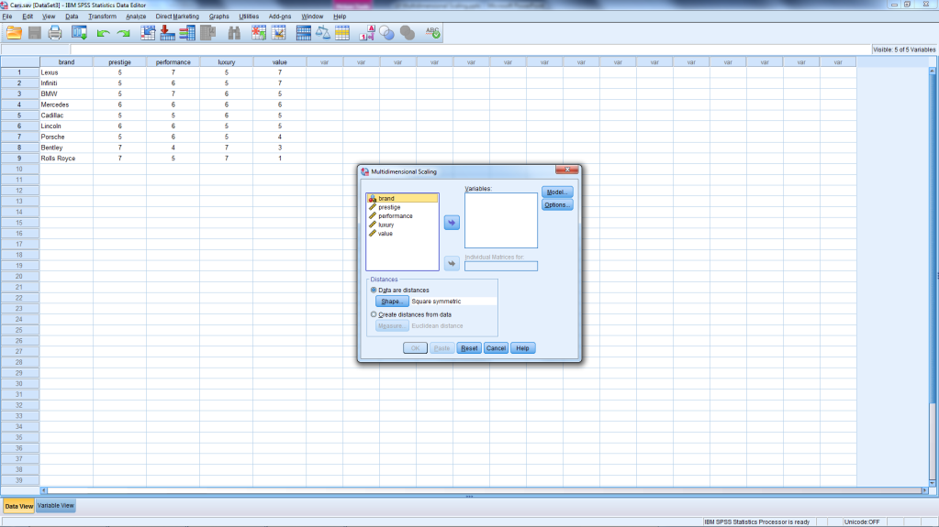
Attribute-based Data open ‘Cars.sav’
Cars.sav
Are we mapping brands?
Notes:
Respondents rated each car on 4 attributes.
The scale is 1 to 7, where 1 = Poor and 7 = Excellent

Slide 38
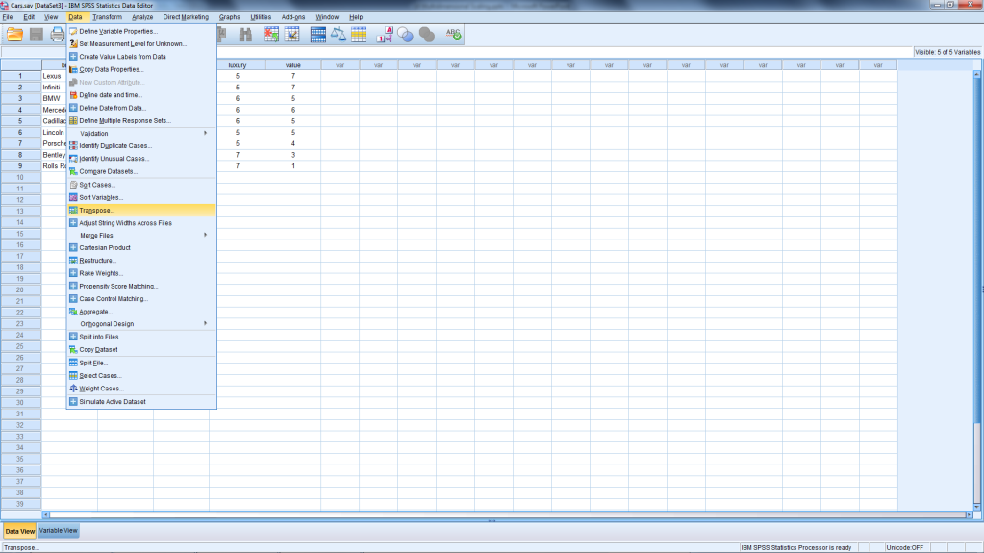
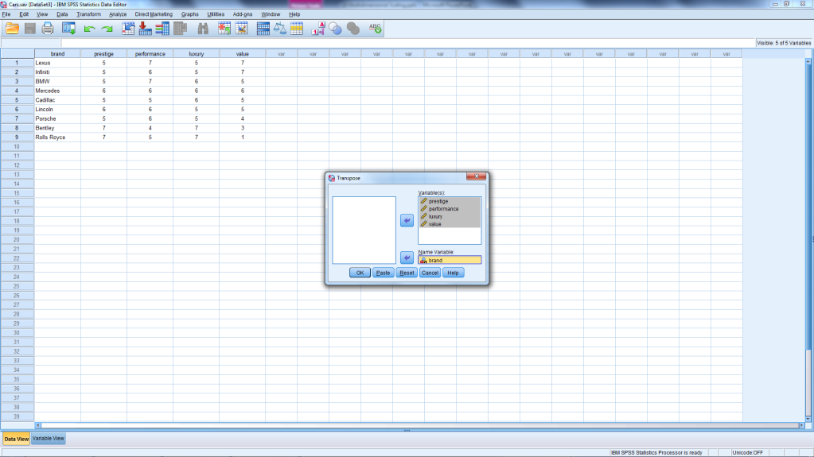
Transpose the File
From Data Menu
Move Brand & Attributes

Slide 39
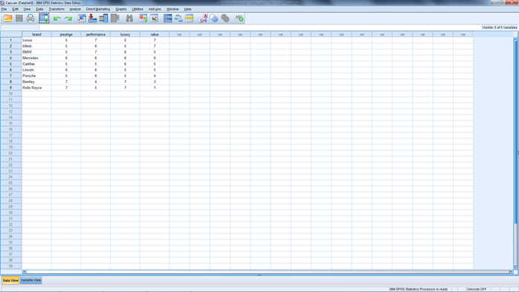
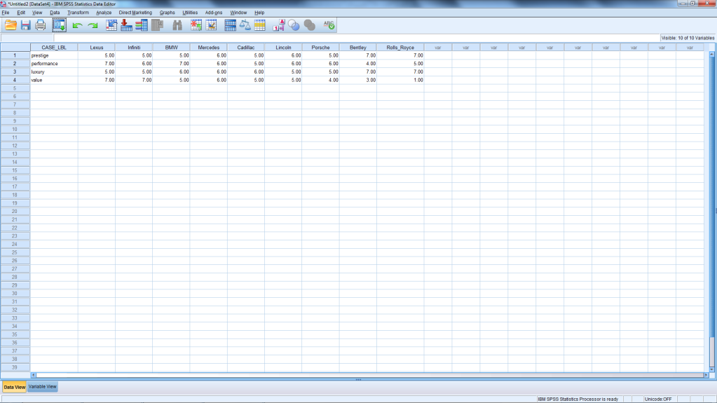
Attribute-based Data
Cars.sav
New Data File
Notes:
Data: attribute ratings matrix
Ratings of each car on each attribute
1 = left end of scale
7 = right end of scale

Slide 40
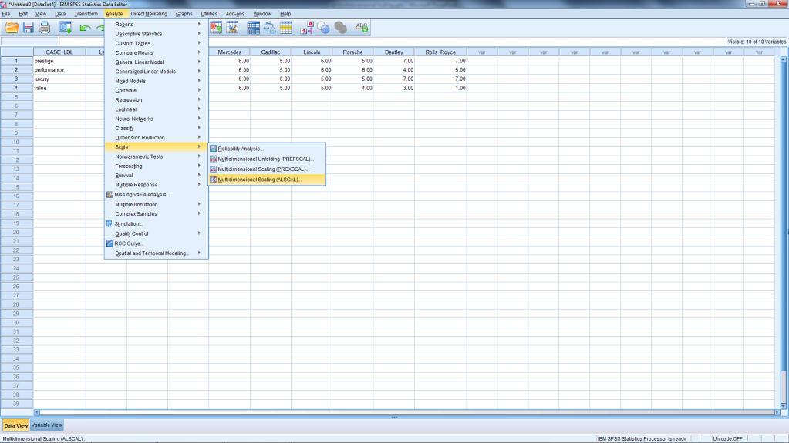
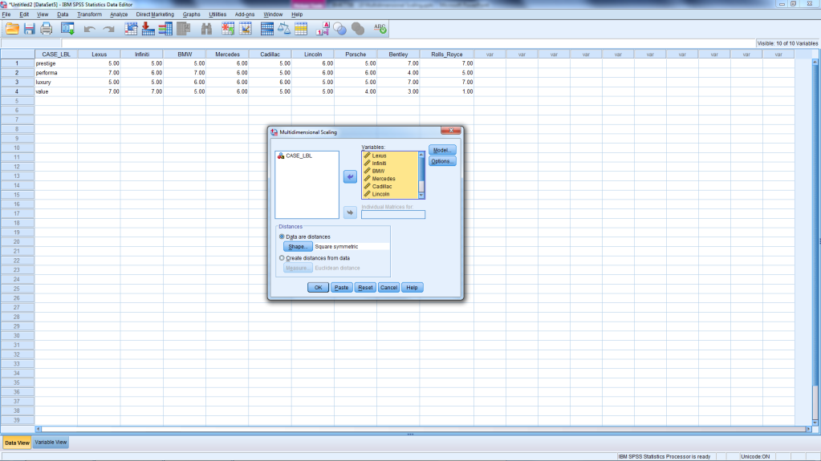
MDS
ALSCAL
Add Cars
Notes:
Method
Imagine the cars in 4 dimensional space
Calculates a distance from data
If D′_{AB} ≤ D′_{CD} then D_{AB} ≤ D_{CD}
Minimize size of mistakes

Slide 41
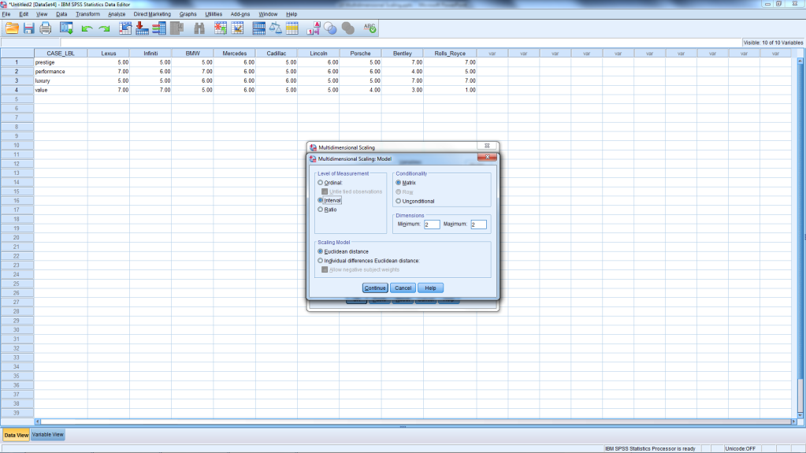
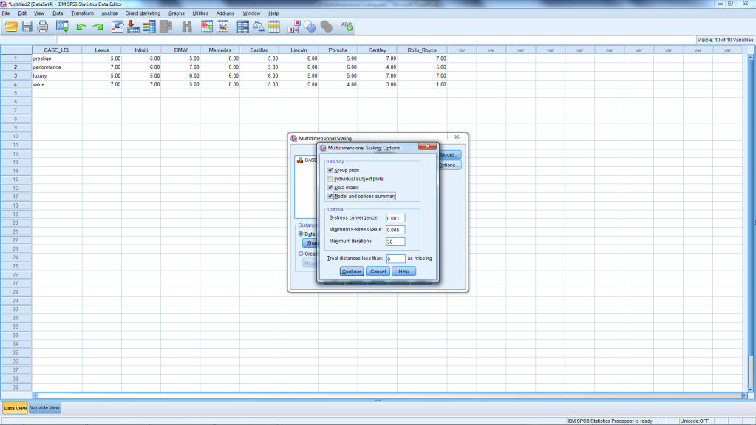
MDS
Model
Options

Slide 42
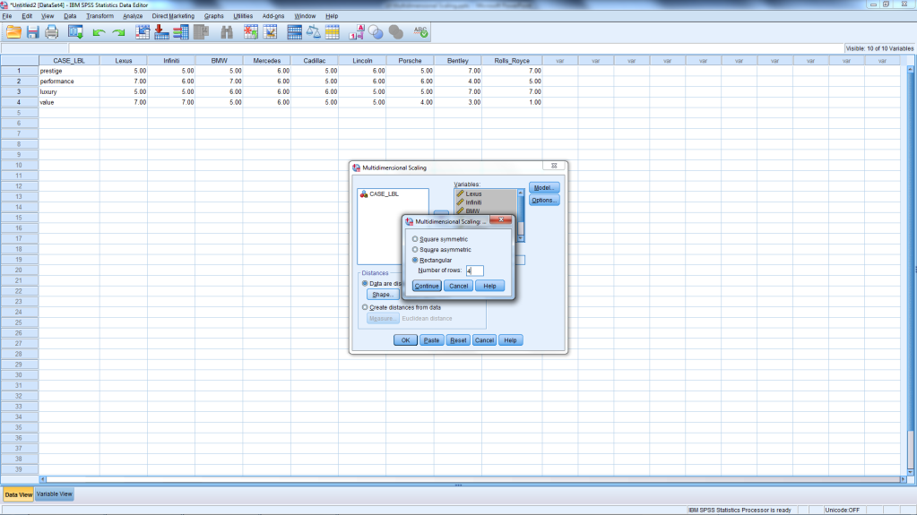
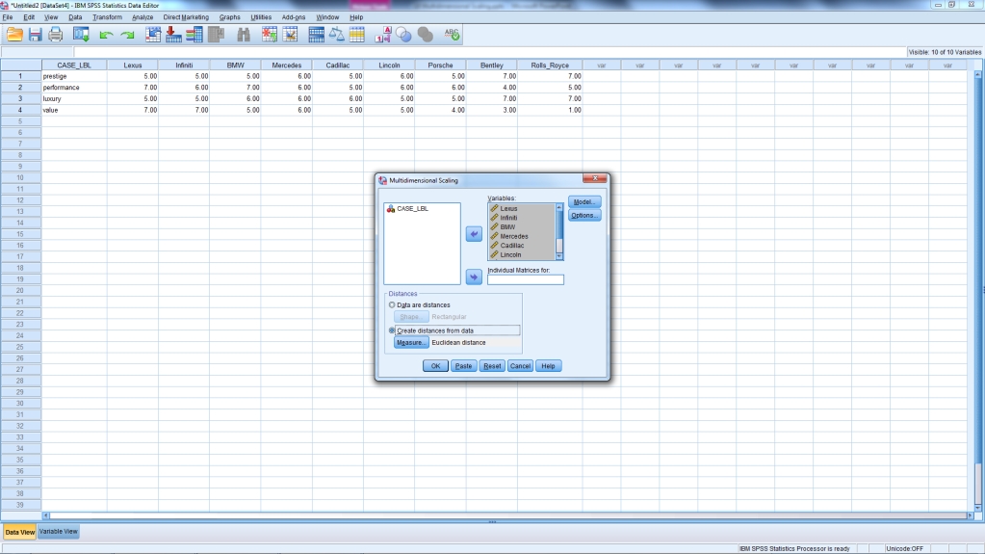
Indirect Approach
Shape
Create Distance from Data

Slide 43
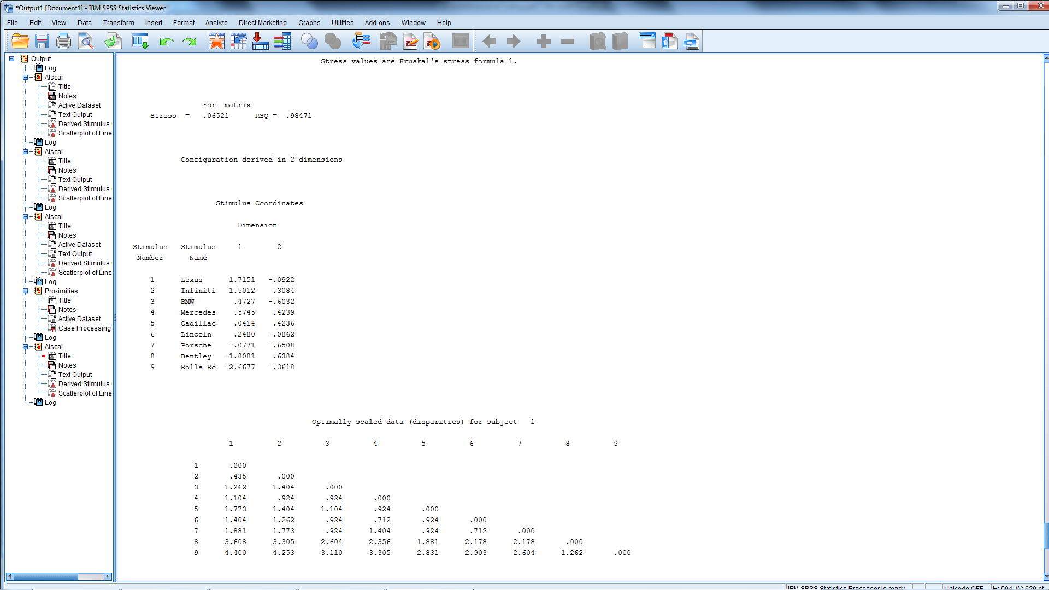
Output: Stress, Coordinates, & Distances

Slide 44
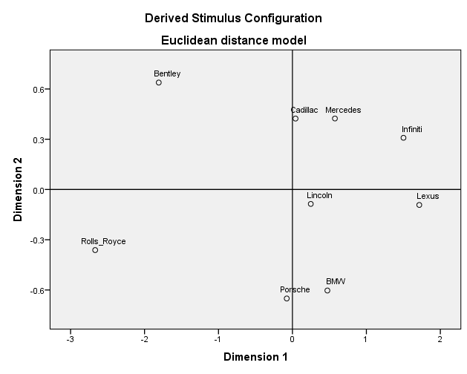
Name the Dimensions
Notes:
Based on the positioning of the cars, Dimension 1 may be interpreted as prestige, with prestige increasing from right to left. Thus, Rolls Royce, as the most prestigious car, has the highest positioning on this dimension and Lexus the lowest. Dimension 2 may be interpreted as Performance, with performance increasing from top to bottom. Thus, Porsche has the highest performance and Bentley the lowest. Bentley has the second highest prestige.

Slide 45
Comparison of Methods
Method | Advantages | Disadvantages
Direct: Similarity-based | Allows for respondents’ criteria (no attribute list) May capture intangible attributes Useful for attributes that are hard to describe | Difficult to name the dimensions Difficult to combine judgments of respondents Criteria for comparisons depend on brands evaluated May be a difficult task for respondents
Indirect: Attribute-based | Facilitates naming dimensions Easy to use Easy to collect data Easier to group respondents with similar perceptions | Requires complete set of attributes Criteria for comparisons depend on attributes evaluated Assumes perceptions of brands is equal to sum of perceptions of attributes
Notes:
The Non-attribute (direct) approach has the following advantages and disadvantages:
The researcher does not have to identify a set of salient attributes.
Consumers use criteria that are important in perceptions
The disadvantages are that the criteria are influenced by the brands or stimuli being evaluated.
Furthermore, it may be difficult to label the dimensions of the spatial map.
Since respondents can use any criteria to judge similarities, it may be difficult to combine perceptions of respondents
The attribute-based (indirect) approach has the following advantages and disadvantages:
It is easy to identify respondents with homogeneous perceptions.
The respondents can be clustered based on the attribute ratings.
It is also easier to label the dimensions.
A disadvantage is that the researcher must identify all the salient attributes, a difficult task.
The spatial map obtained depends upon the attributes identified.
It may be best to use both these approaches in a complementary way.
Direct similarity judgments may be used for obtaining the spatial map
The attribute ratings may be used as an aid to interpreting the dimensions of the perceptual map.

Slide 46
Break

Slide 47
Create Your Own Maps
Both Methods

Slide 48
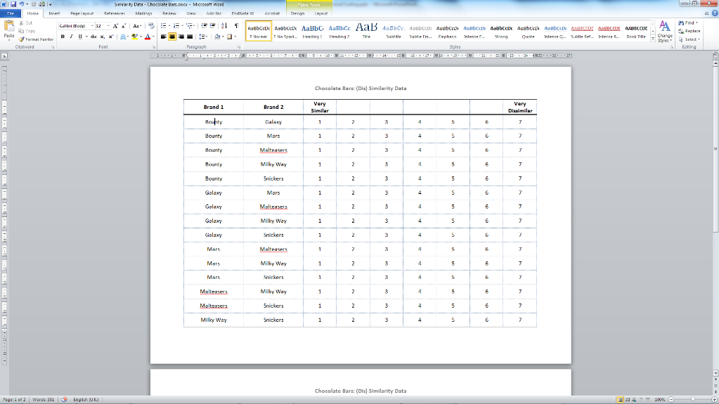
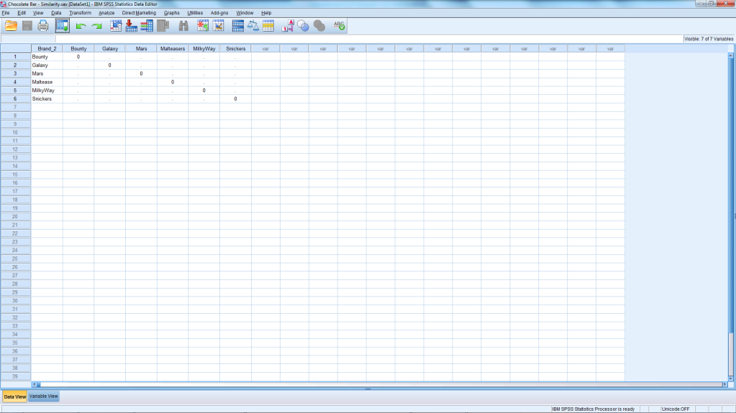
Chocolate Bar – Similarity.sav
Prepare Ratings
Complete Data File
Notes:
Complete similarity assessments on the worksheet provided
Ignore second page for now
Complete the file named chocolate bar - similarity.sav as shown above
Rows & columns are brands
The intersection is the ‘distance’ between the brands
Complete only the lower triangle
Data file is symmetric
Brand 1 to Brand 2
Brand 2 to Brand 1
The diagonal is the brand paired with itself

Slide 49
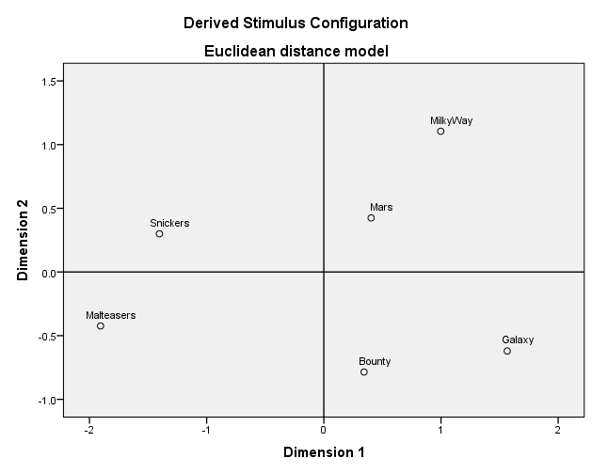
Plot Your Perceptions & Name Axes
Notes:
Analyze → Scale → Multidimensional Scaling (ALSCAL)
Variables: 6 Brands
Distances Box:
Tick: Data are distances
Shape: Square Symmetric
Model
Interval data
Scaling Model: Euclidean Distance
Conditionality: Matrix
Dimensions: 2 to 2
Continue
Options
Check Group Plots
Model Options & Summary
Continue
Add your map here and try to name the dimensions.
Vertical: Nought or Not
Horizontal: Crunchiness

Slide 50
Similarity-based Map Issues
Was it easy to provide the data?
How would the map change with:
M&Ms or Licorice added to set?
Regarding the dimensions:
Did everyone use same dimensions?
Were they easy to name?
Advantages?
Respondents use own criteria
Can capture attributes that are difficult to describe
Can capture intangible attributes
Can capture unknown attributes
7 – 10 chocolate bars?

Slide 51
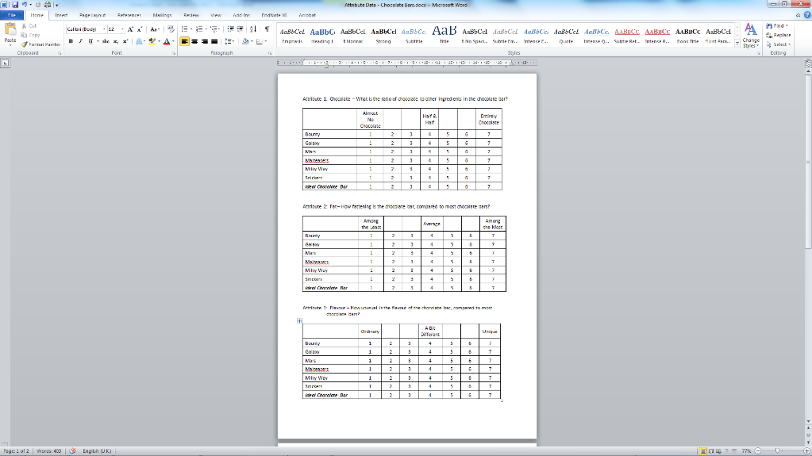
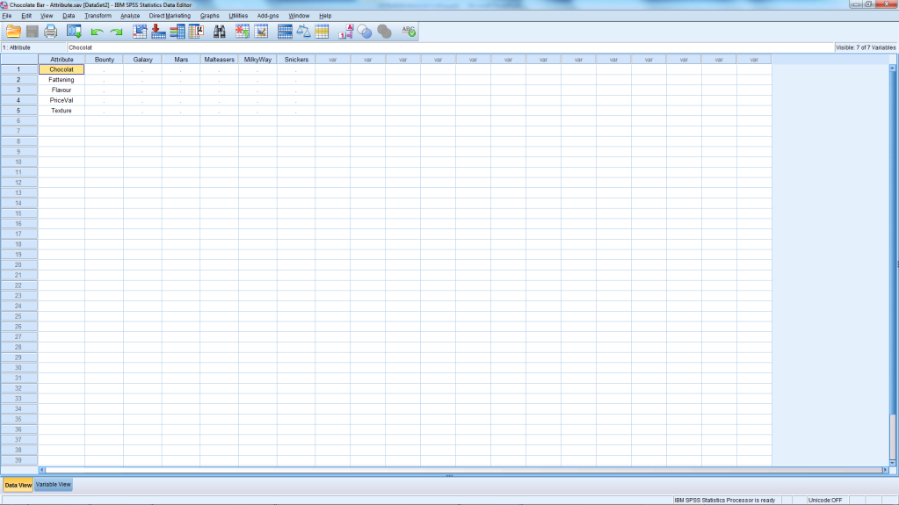
Attribute-based data.sav
Ignore Ideal Bar for Now
Complete Data File
Notes:
Complete attribute evaluations
For now, ignore the row for Ideal Chocolate Bat
Complete the file named chocalate bar - attribute.sav as shown above
Columns are the brands
Rows are the attributes
Input the evaluations of each brand on each attribute

Slide 52
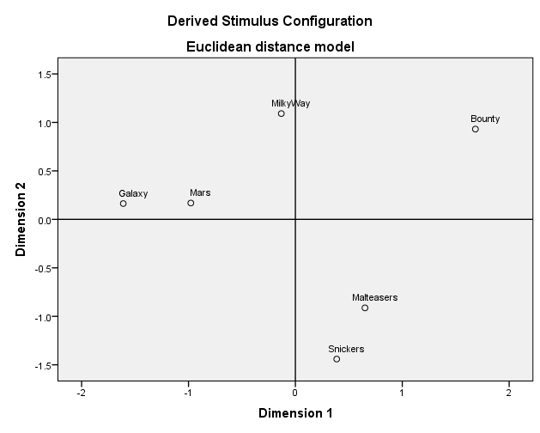
Plot Your Perceptions & Name Axes
Notes:
Analyze → Scale → Multidimensional Scaling (ALSCAL)
Variables: 6 Brands
Distances Box:
Shape: Rectangle
Rows: 5
Tick: Create distance from data
Euclidean distance
Model
Interval data
Scaling Model: Euclidean Distance
Conditionality: Matrix
Dimensions: 2 to 2
Continue
Options
Check Group Plots
Model Options & Summary
Continue
Add your map here and try to name the dimensions.
Vertical: Crunchiness
Horizontal: Chocolatey

Slide 53
Attribute-based Map Issues
Was it easy to provide the data?
How would the map change with:
If an important attribute was missing?
Different attributes?
Different brands?
Regarding the dimensions:
Did everyone use same dimensions?
Were they easy to name?
Disadvantages?
Respondents use criteria provided
Assumes perception is sum of evaluated attributes

Slide 54
Compare Your Maps
Similarity-based
Attribute-based
Notes:
Put a copy of each map on this slide to make the comparison easier.

Slide 55
Compare the Maps
Are there any differences?
Why would these occur?
Naming the dimensions
Similarity-based map:
Attribute-based map:

Slide 56
Adding Preferences
MDS Procedures

Slide 57
Similarity Data With Preferences
Bounty
Mars
Milky Way
Snickers
Ideal Chocolate Bar
Galaxy
Maltesers
Picture your Ideal Chocolate Bar
Repeat the Rating Task
1 is very similar to 7 is very dissimilar
21 Pairs to evaluate
See second page
Update data file
Ideal row and column
Add additional rankings
Create a perceptual map as before

Slide 58
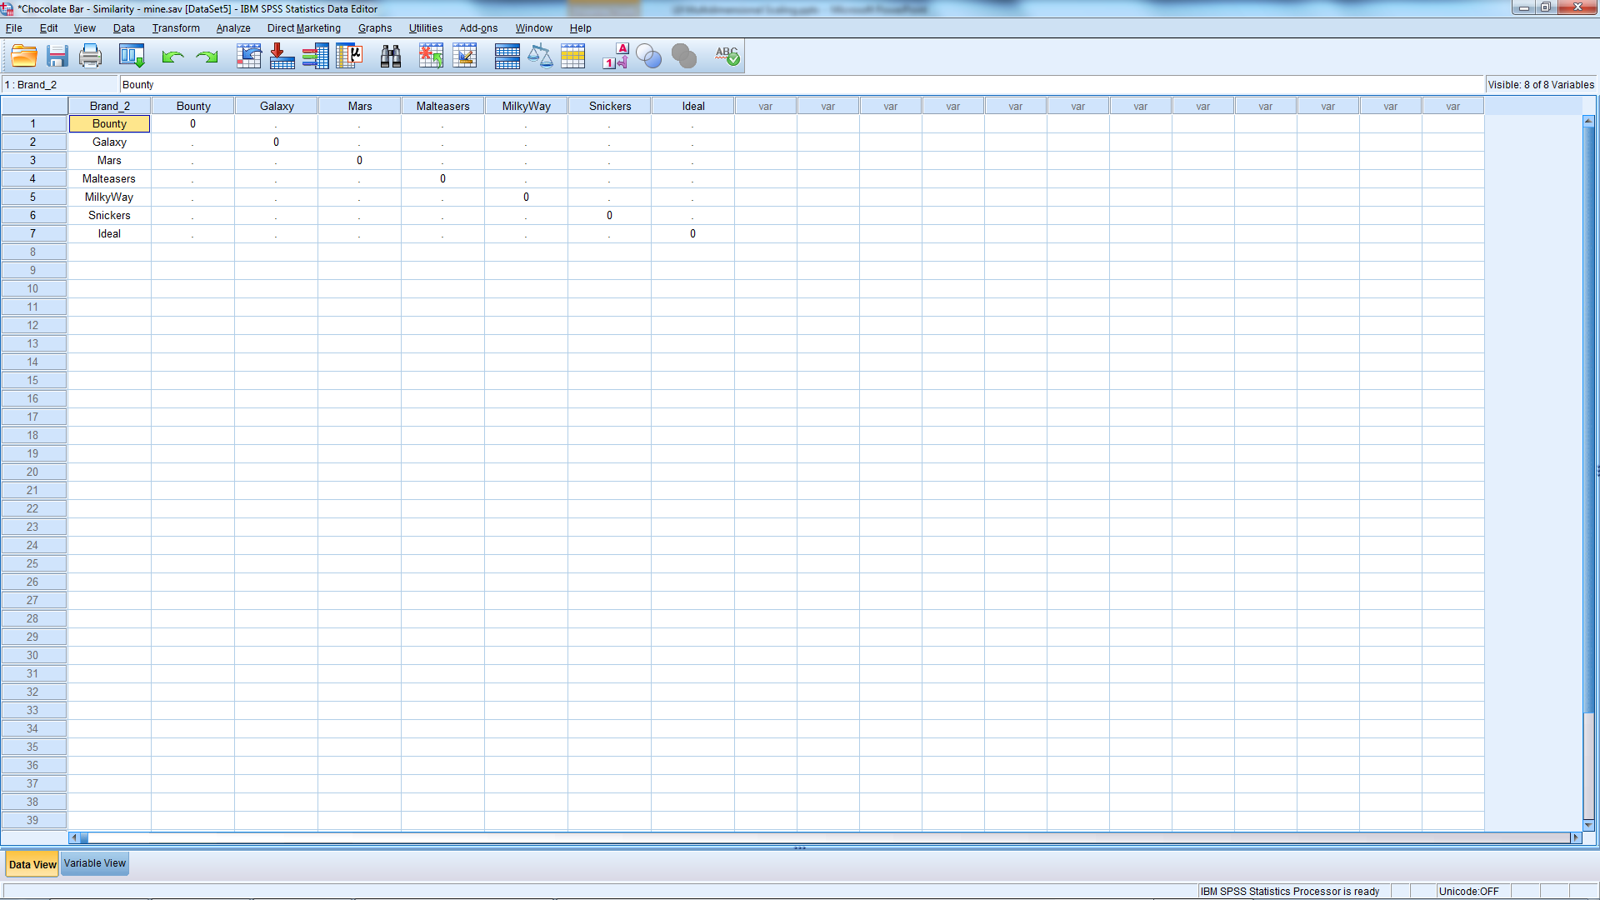
New Data File
Notes:
To add preferences, add the ideal brand.
The respondent adds 6 more ratings which reflect the comparison of each provided chocolate bar with the ideal chocolate bar in mind.
In this case another 6 comparisons are added to the data file.
Similarity vs. Preference: Determine whether the brands will be compared on the basis of their similarity or of their preference.
Similarity-based perceptual maps reflect brand similarities and dimensions of comparison, but don’t provide any insights into why the brands would or would not be chosen.
Preference-based perceptual maps, on the other hand, reflect preferred choices, but consumers may compare brands on different dimensions that don’t match the similarity-based perceptual maps. In the case of these chocolate bars, some may actually move when the pairs are reevaluated with the ideal brand included.

Slide 59
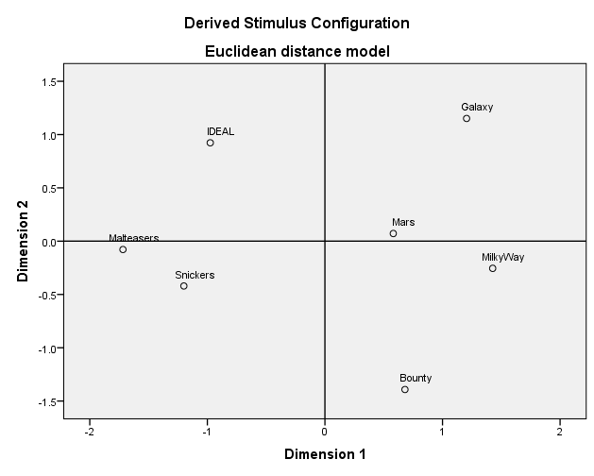
Map with Preferences

Slide 60
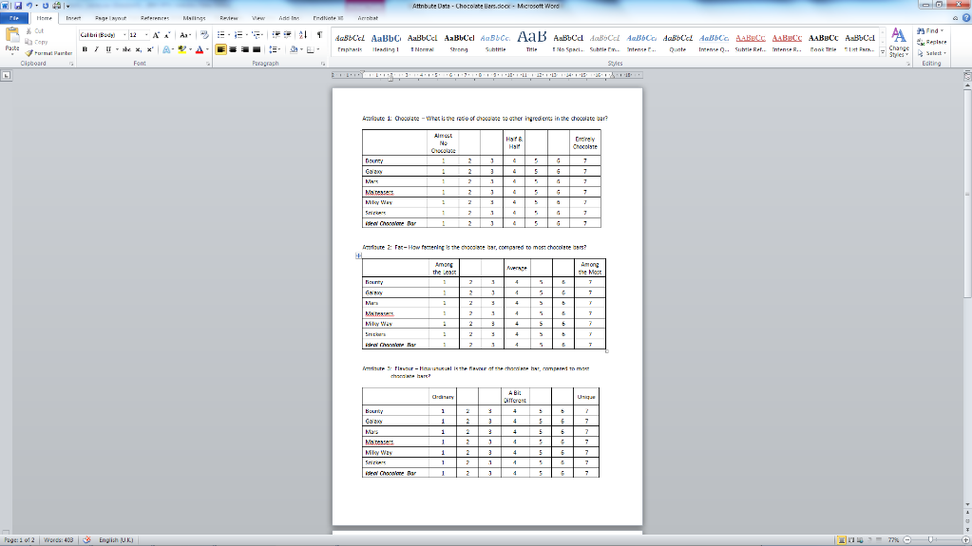
Attribute Data With Ideal Brand
Picture your Ideal Chocolate Bar
Repeat the Rating Task
Rate your ideal chocolate bar
On each attribute
Add the ideal brand to data file
Variable view:
Add row
Ideal Chocolate Bar
Data view:
Add ideal level of each attribute
Complete column labeled ideal
Create brand map as before

Slide 61
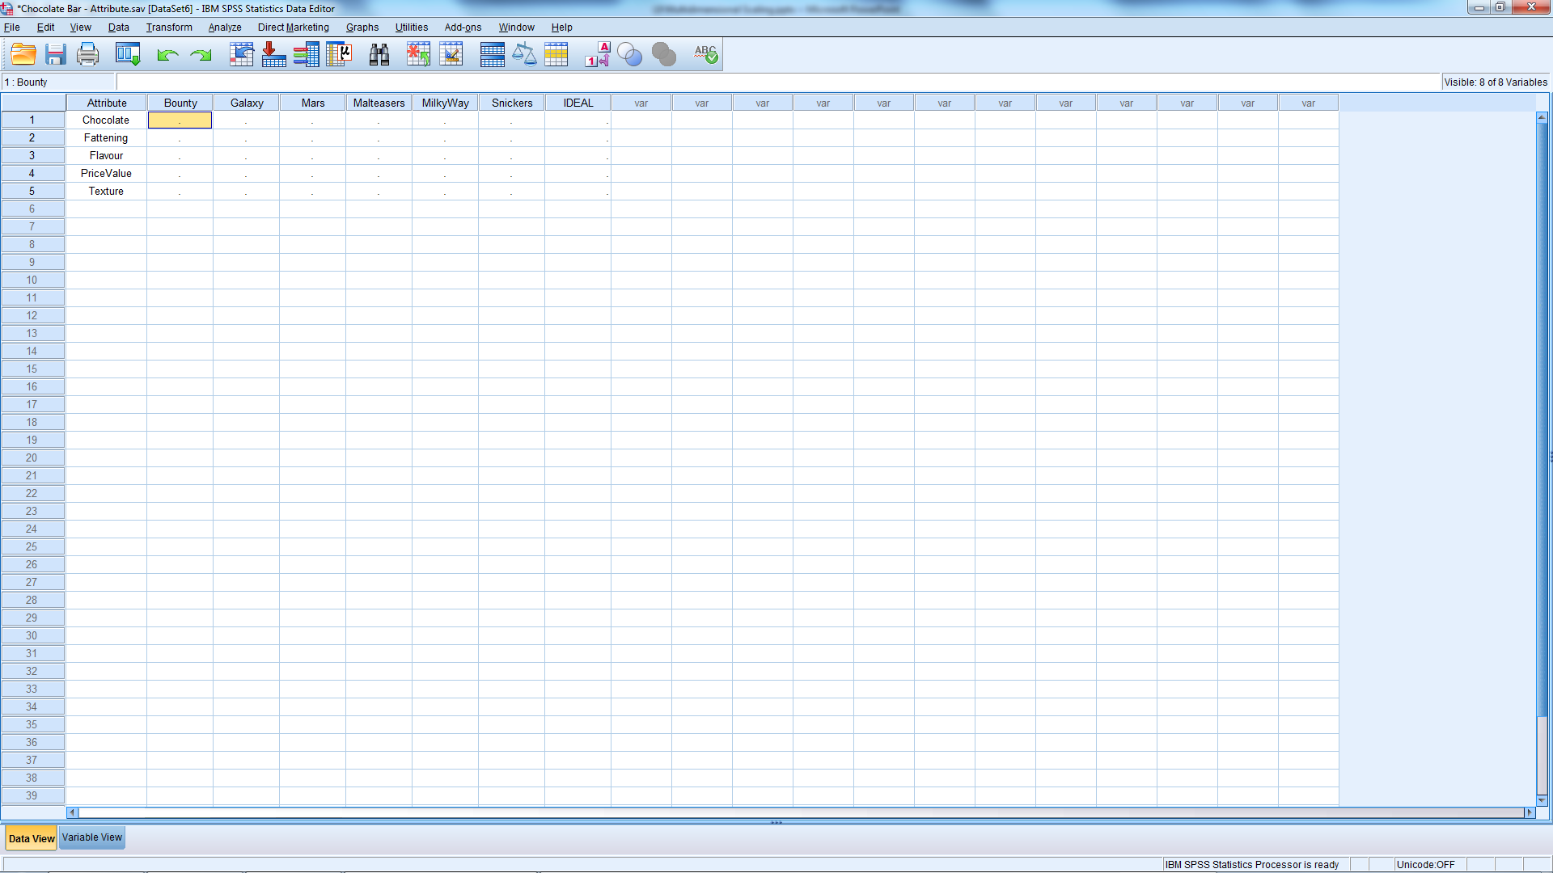
New Data File

Slide 62
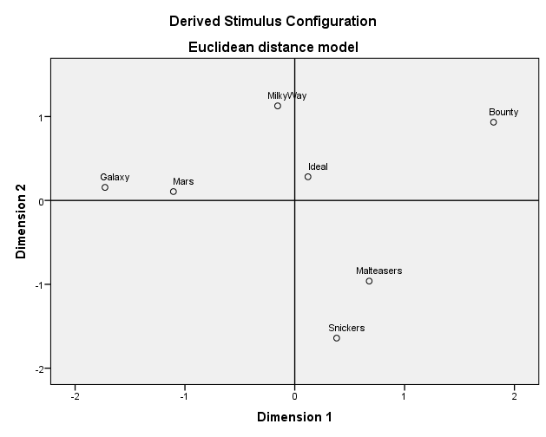
Map with Preferences

Slide 63
More than one Person
MDS
Notes:
This section will not be covered during lecture. These notes are just for your future reference.
Disaggregate (individual) analysis:
Allows for construction of perceptual maps on a respondent-by-respondent basis
Assessment of variation among individuals.
Provides a basis for segmentation analysis.
Aggregate (group) analysis:
Creates perceptual maps of one or more groups
Helps understand overall evaluations of objects and/or dimensions employed in those evaluations.
Should be found by using the average evaluations of all respondents within a group.

Slide 64
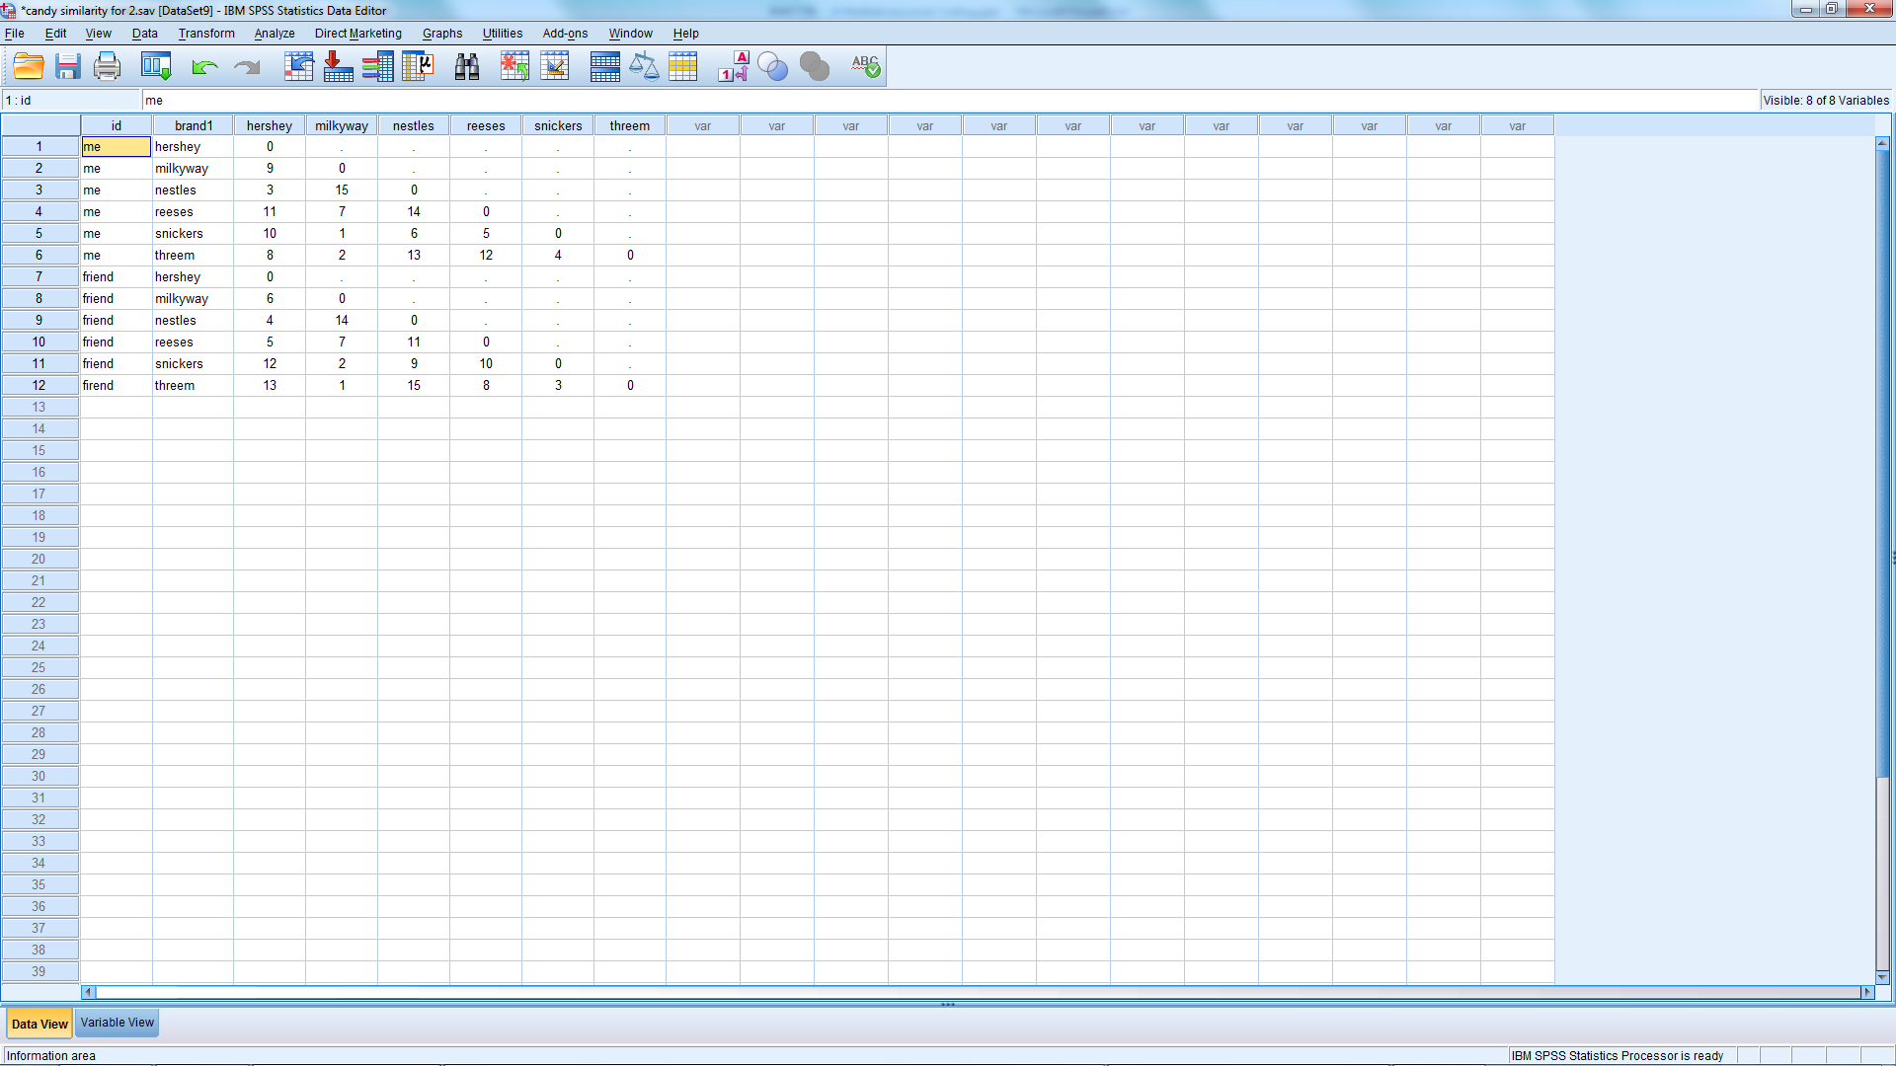
For More than One Respondent
Notes:
Input data for second respondent
Directly below previous data
No blank lines
Use new id

Slide 65
For More than One Respondent
Option 1
Put Split File On
Get separate map for each person
Option 2: Everyone on same map
Assumption:
Everyone uses same dimensions
Dimensions are equally useful
Avg. Similarity Rank for each brand pair
Reorder
Run as if one person

Slide 66
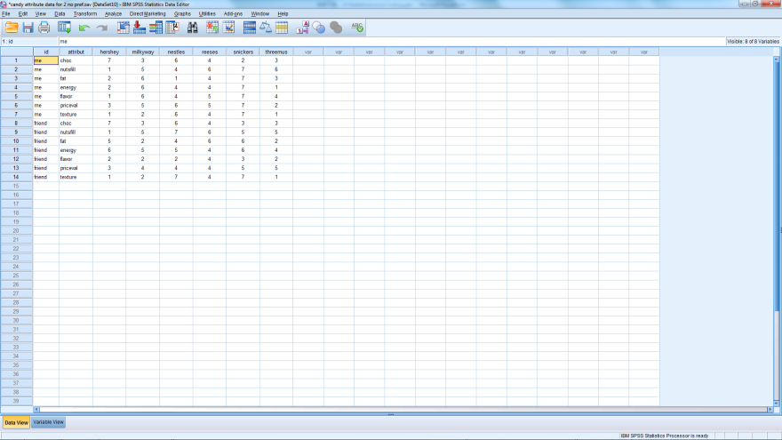
For More than One Respondent
Attribute-based Method
Creating Data File
Input data for other respondents
Directly below previous data
No blank lines
Use new id

Slide 67
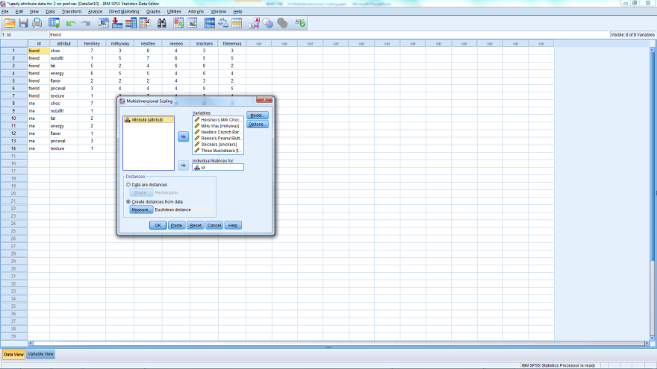
1 Map per Person
Option 1
Dialog Box
If more than 1 respondent
Select id
Hit arrow by Individual Matrices For:

Slide 68
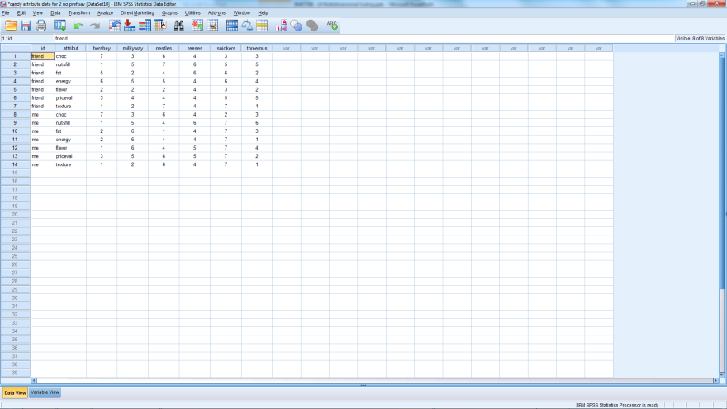
1 Map per Group
Attribute-based Method
Creating Data File
Average rating for each brand on each attribute
Do this computation in Excel
Run as if one person
Create average ratings by segment
Run as if each segment was 1 person

Slide 69
What’s next?
Topic
Read
Group Assessment Work Time
Read chapter 6,7 & 10

Slide 70
Discuss the group coursework

